Slide 1

E-application and monitoring system introduction
about LEADER project applicant and LAG partner
Zirlin Raudsik
ARIB Analysts
Development grants department
24.05.2024

Slide 2
Main topics
General basic information
  What is new at at new period 2021-2027
Automatic Controls with EDI
A8.4.1 LEADER LAG grant e-application
A842 LEADER grant project e-application

Slide 3
New period 2021-2027
Development grants- buildings, eqipment, local activities
Direct grants- area and animal based measures
26 agricultural Local activity groups
8 fisheries Local activity groups
LAG grants intervention A8.4.1
LEADER project grants intervention A8.4.2
NEW -Simplified cost options SCO
  flat rate for LAG grant A841
  draft budget+lump sum LEADER project grant intervention A842
Notes:
flat rate for LAG grant A841 -

Slide 4
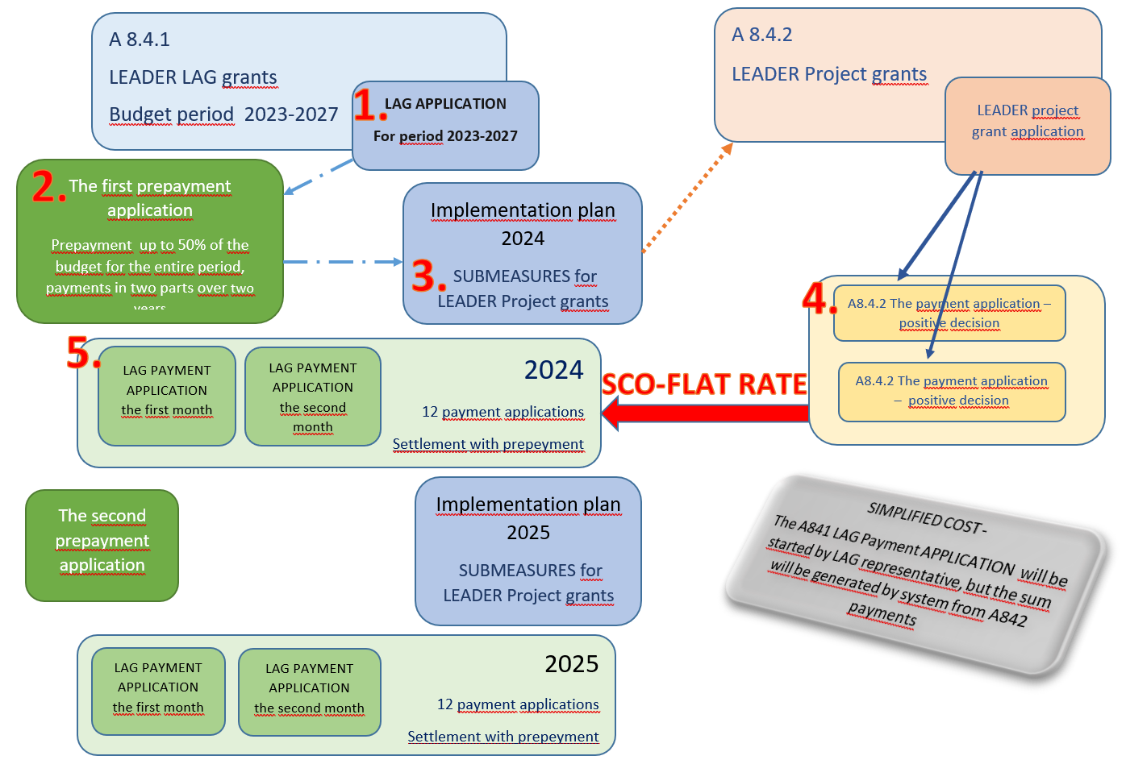

Slide 5
Automatic controls with EDI
ARIB has electronic data exchange with the registers of 13 other institutions
Business register
Taxpayer's register
Estonian address data register
Cadastral register
Land register
Building register
Criminal records register
Population register
The agricultural board information system
Notes:
EDI- electronic data interchange
Electronic data interchange (EDI) is the automated exchange of business documents or information, datas between organizations. Daily business workflows require the exchange of documents like invoices, purchase orders, and shipping forms.
In Estonia, EDI is called x-road
Cadastral register- The land cadastre is a general national register the objective of which is to register information reflecting the spatial extent of immovable's boundaries, the value of land, the natural status of land and the use of land, and to ensure the quality, maintenance and availability of such information to the public.
Land register - Real estate is a plot of land with buildings, immovable property (plot of land) entered in the land register as an independent unit, development right, apartment ownership or apartment development right.
https://geoportaal.maaamet.ee/eng/Spatial-Data/Cadastral-Data/Landowners-Guide-p729.html#a01
6 controls – Blocker type
DO NOT HAVE A TAX LIABILITY
NOT BANKRUPTCY
CRIMINAL RECORD OF THE APPLICANT
NOT_APPLY_OTHERS
WITHDRAWN_FUND_REFUNDED_OR_DEFERRED

Slide 6
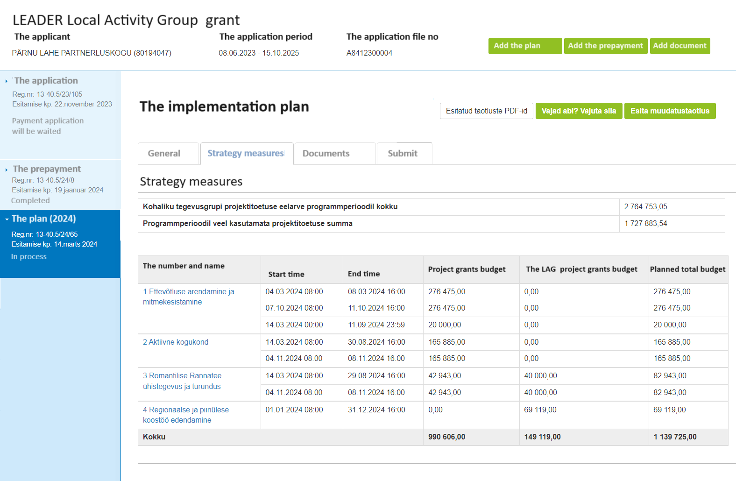
A8.4.1

Slide 7
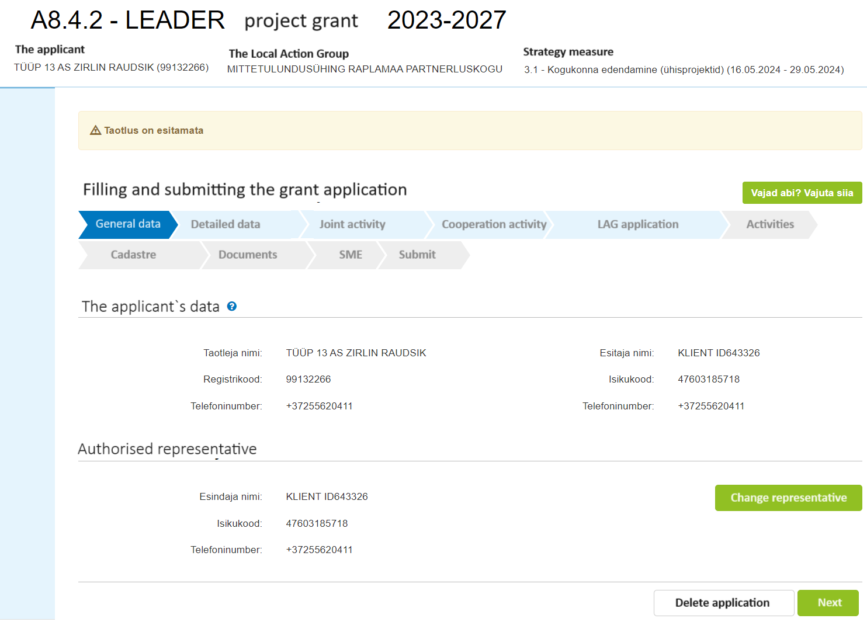
Step 1
General data
There are 10 steps at application
1- General data
2-Detailed data
3- Joint activity
…etc
Some steps opening with related answers

Slide 8
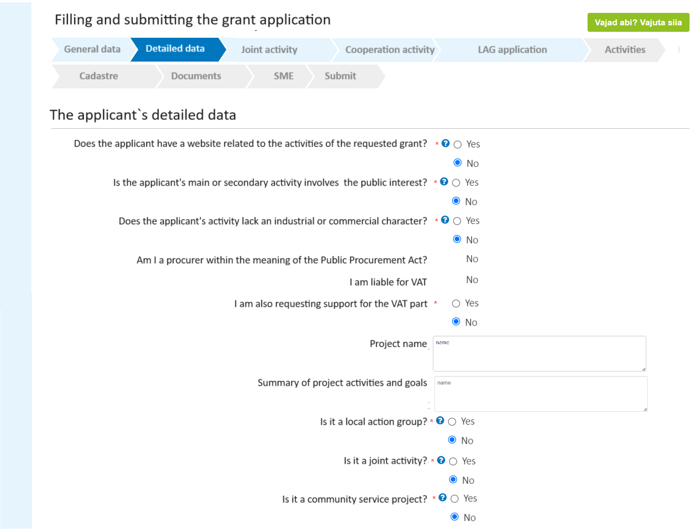
Step 2-1
Different kind of datas could be asked.
Some „Yes“ opens new question
Some „Yes“ opens next step
Answer is given automatically by system

Slide 9
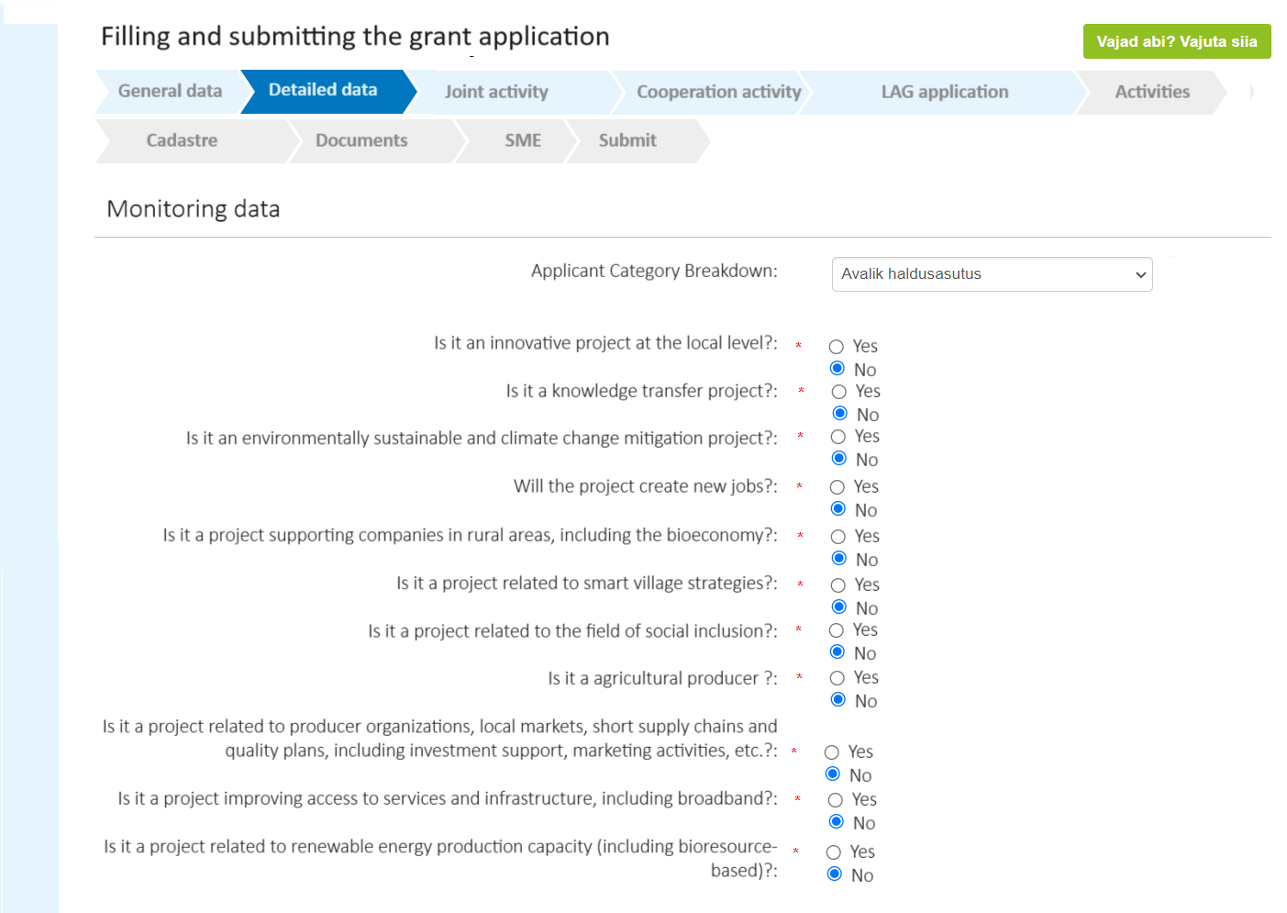
Step 2-2
Preferred data fields:
Classifier- applicant can choose one correct option
question type Yes/No
Give hints what is correct answer
Avoid
Added files
Free text instead numbers

Slide 10
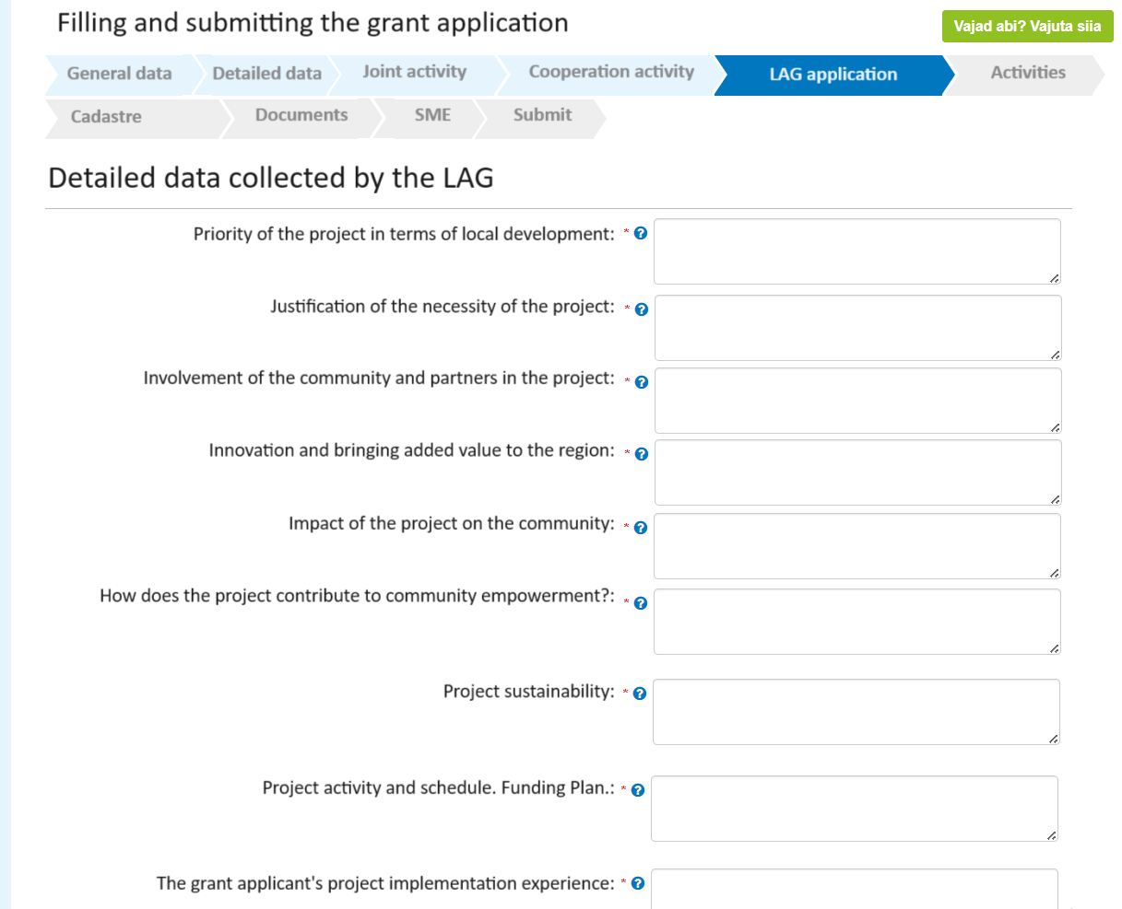
Step3-1
Every LAG has their own application
26 diffrent applications to set up

Slide 11
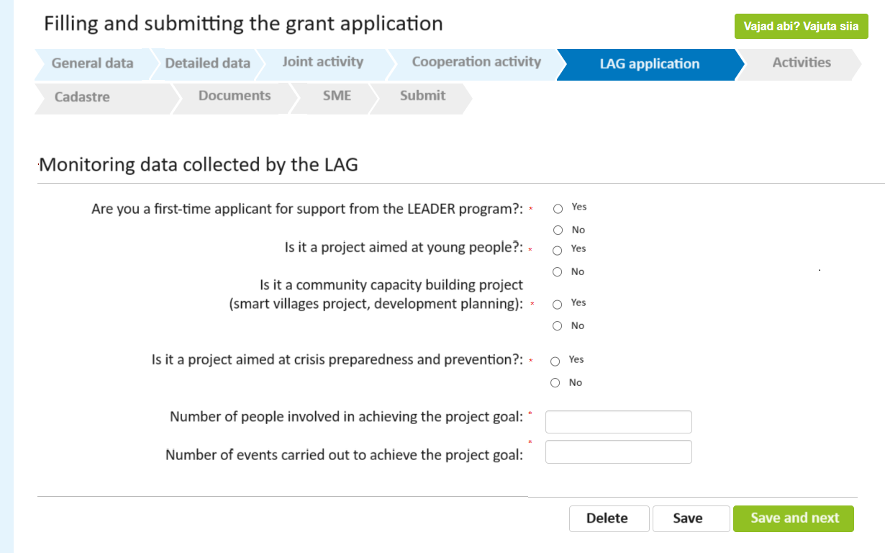
Step 3-2
ARIB collect datas for LAGs

Slide 12
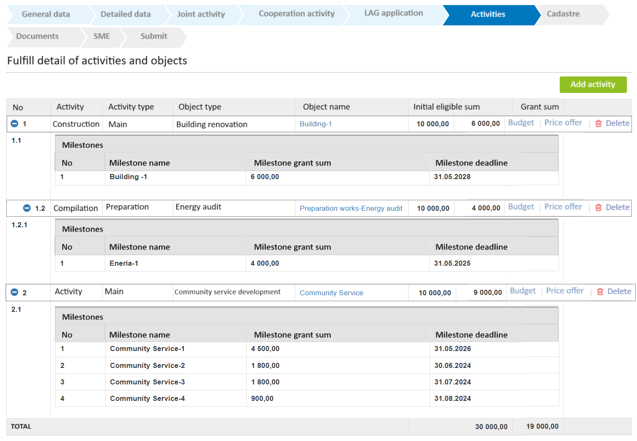
Step-4
Activities
Draft budget+lump sum
Number on milestones are settled into system

Slide 13
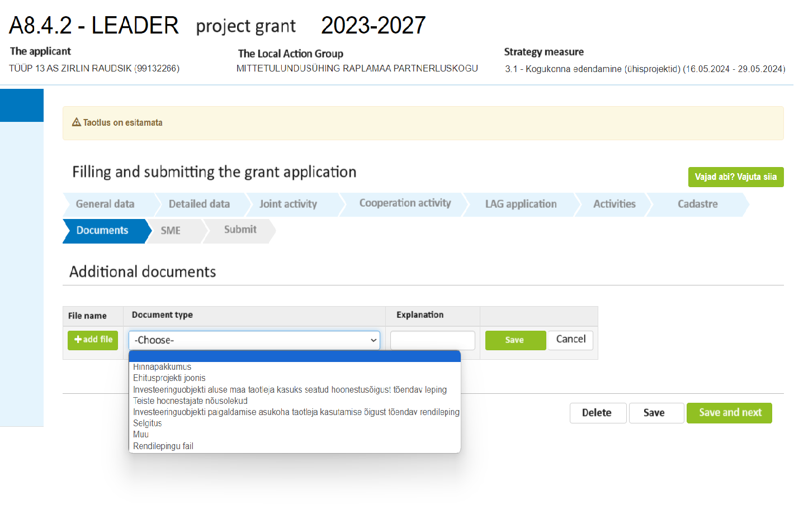
Step-5
Docyment types are set into system

Slide 14
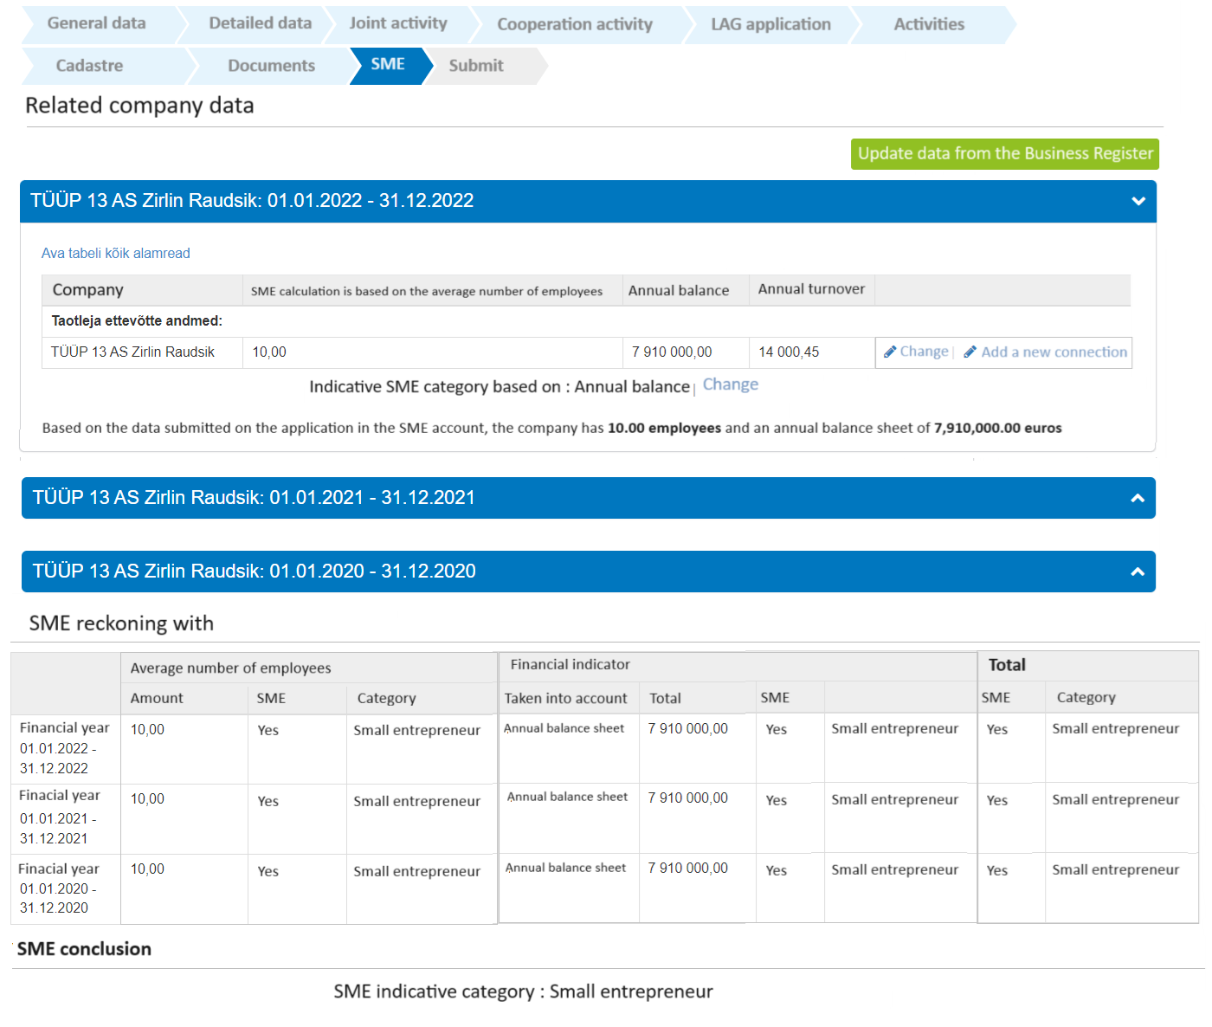
Step-6
SME
The size of the company is identified as follows:
if the applicant company is an Affiliated compnay then 100% of the another affiliated company data will be added to aplicant company data,
if the company is a partner company then a proportional part of its partner(s) data is added to the applicant company data.

Slide 15
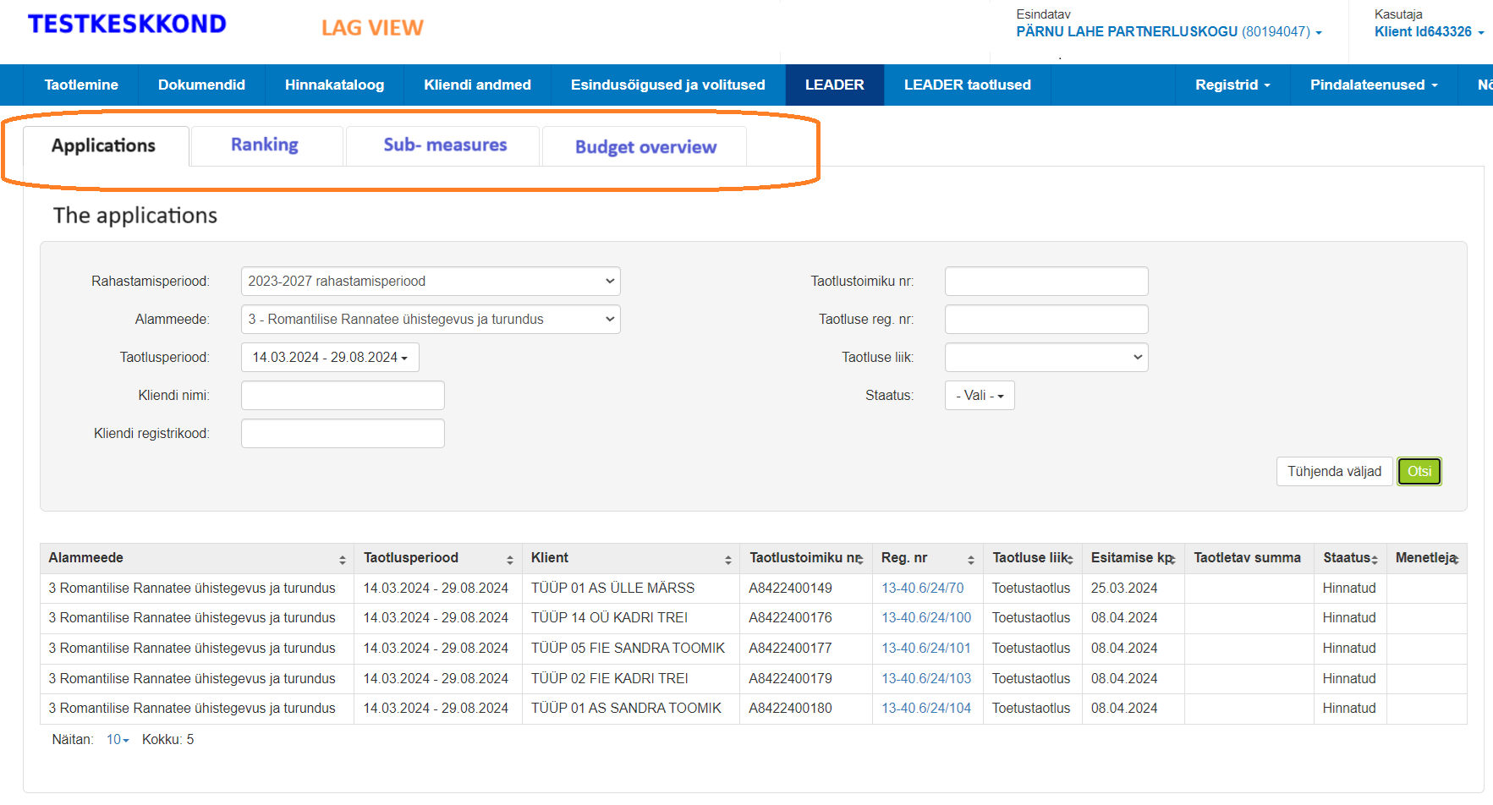

Slide 16
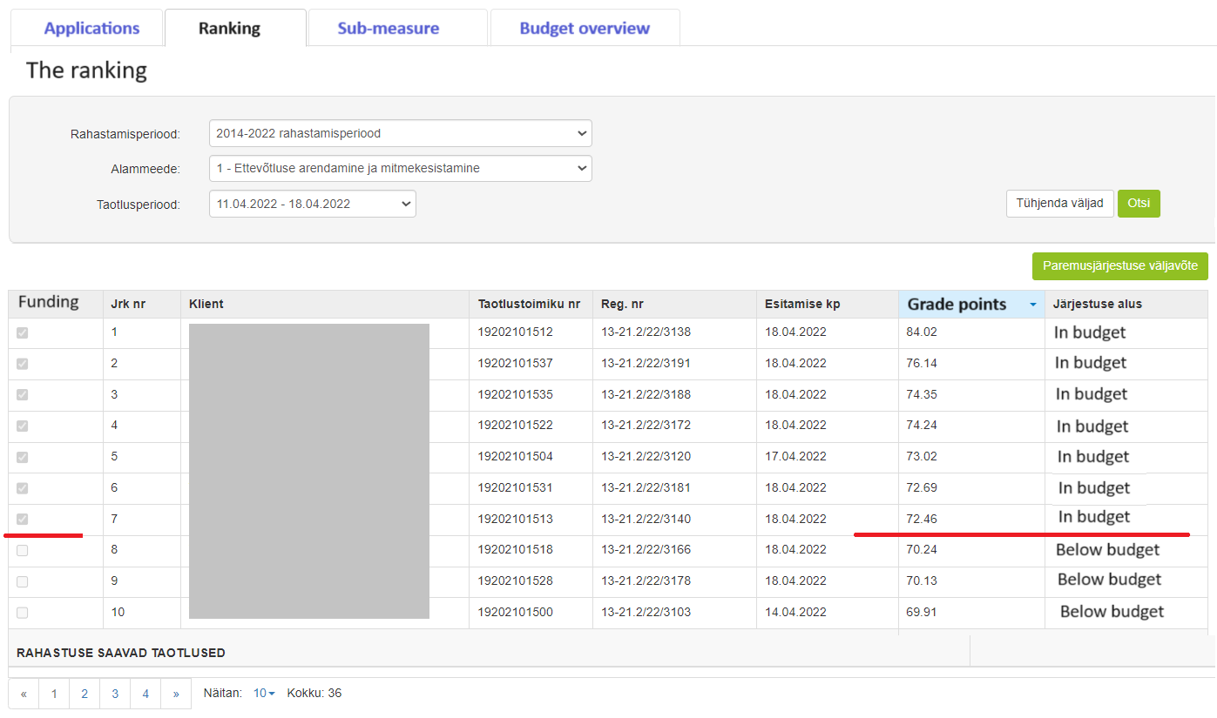

Slide 17
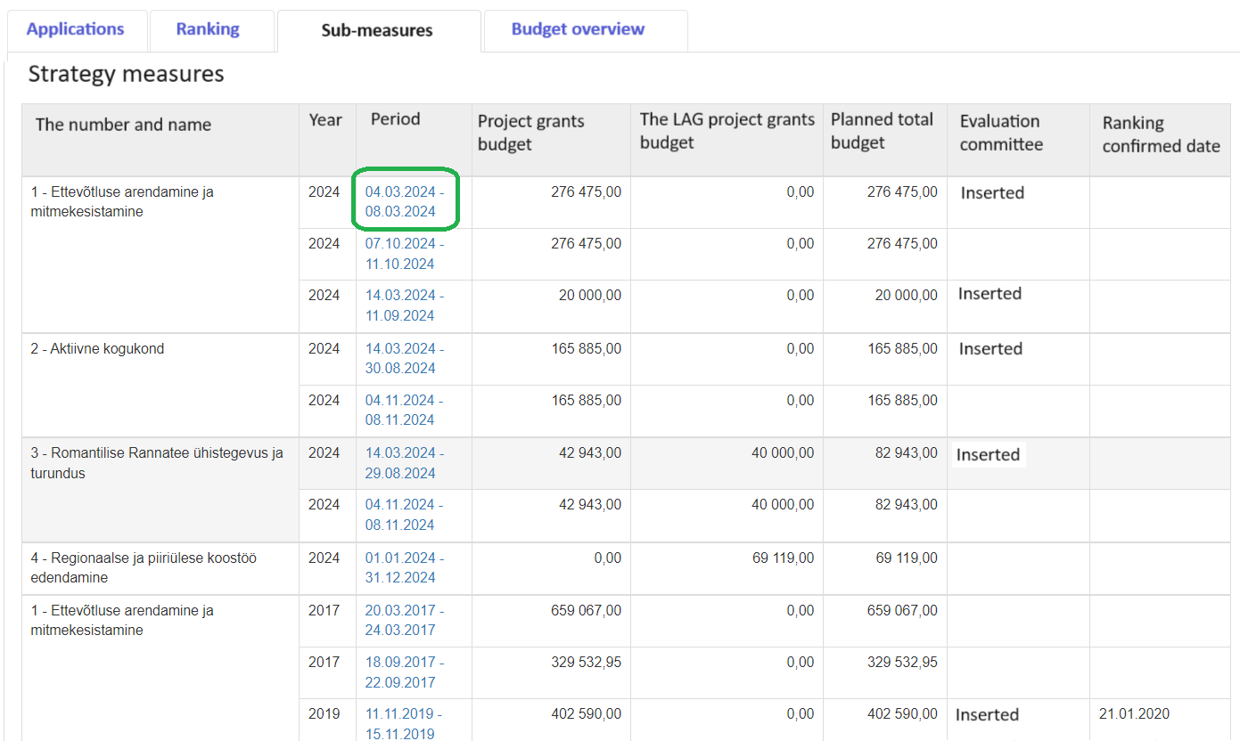

Slide 18
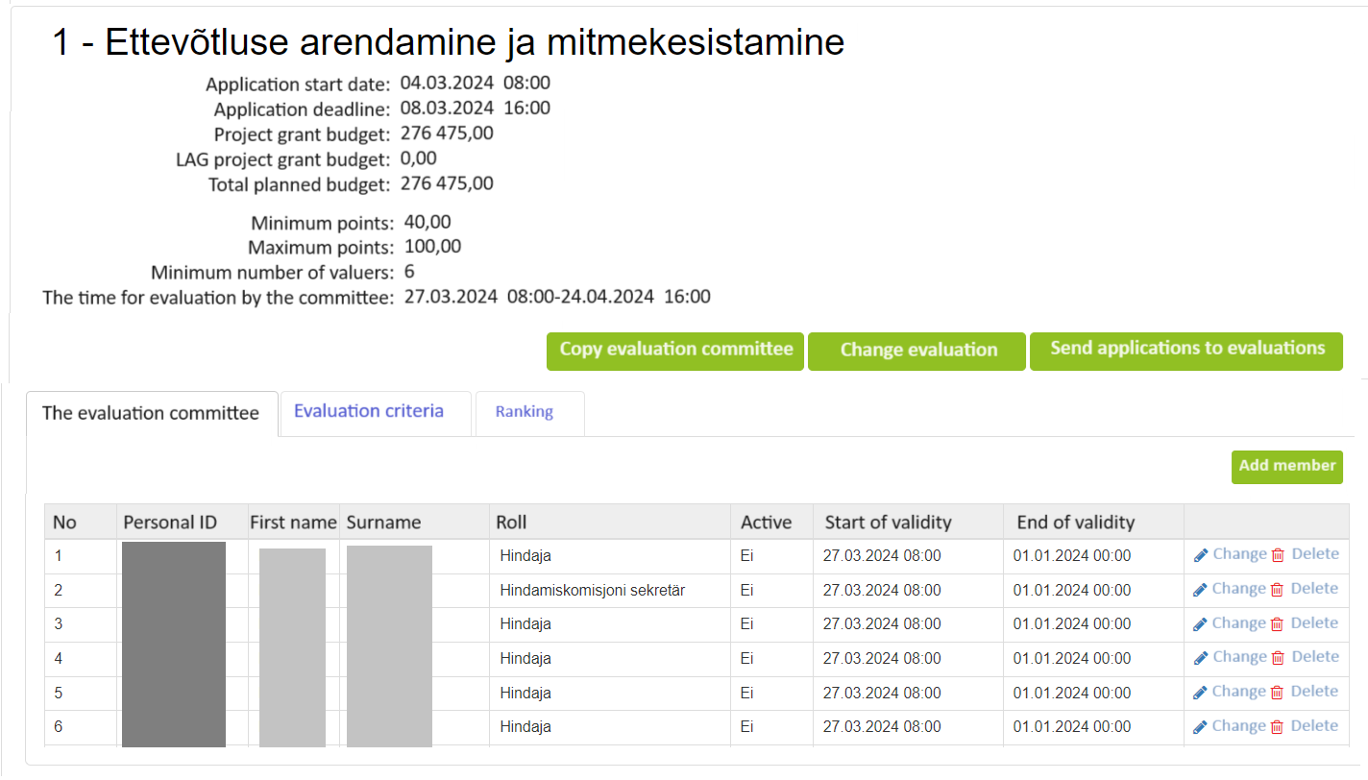

Slide 19
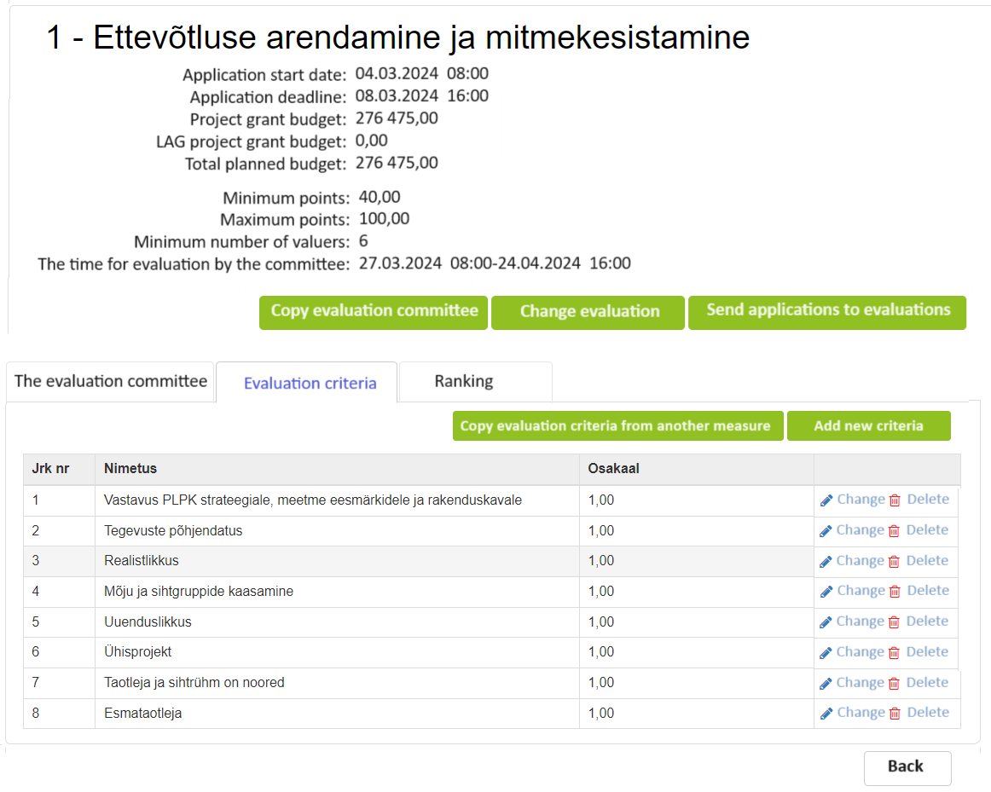
.

Slide 20
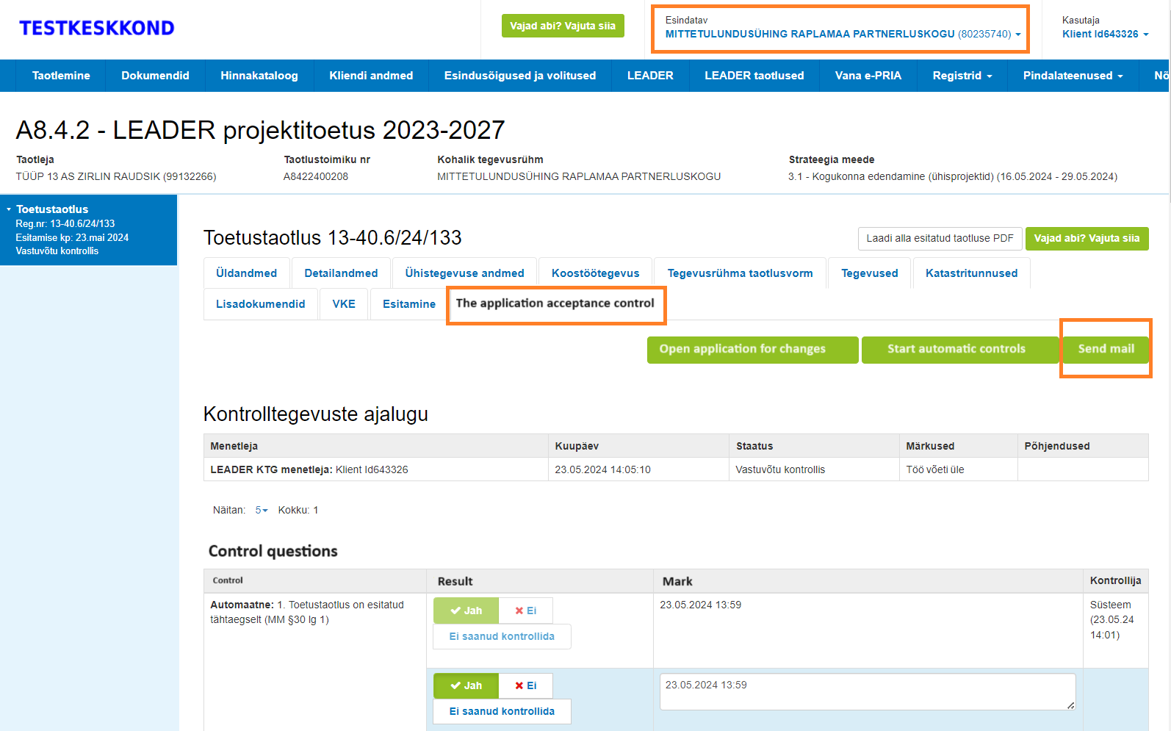

Slide 21
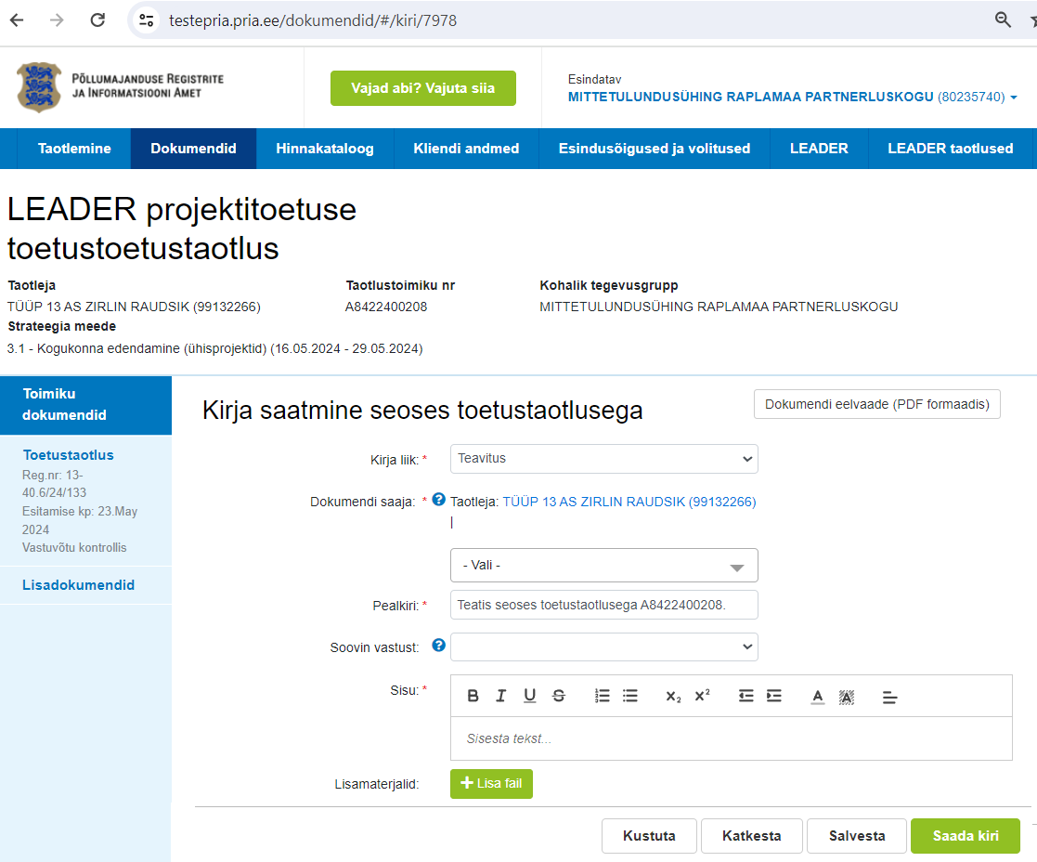
Send letter
LAG can send the inquiry notification from teh project grant application.

