Slide 1


Slide 2




First Science Park in Baltics
Founded in 1992

Slide 3


Mission
Creating an ecosystem – science park - for technology and novel knowledge transfer into business
in Tartu city and South-Estonia region

Slide 4
Mission
INNOVATION
BUSINESS
SCIENCE

Slide 5
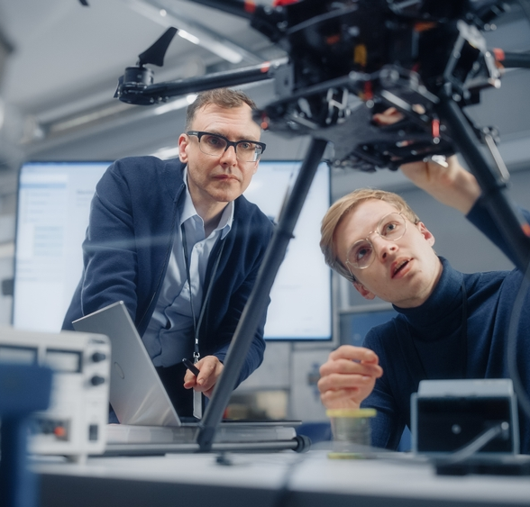
Value Proposition
INCUBATION
SERVICES
OFFICE & LABS
GLOBAL NETWORKS &
KNOWLEDGE

Slide 6
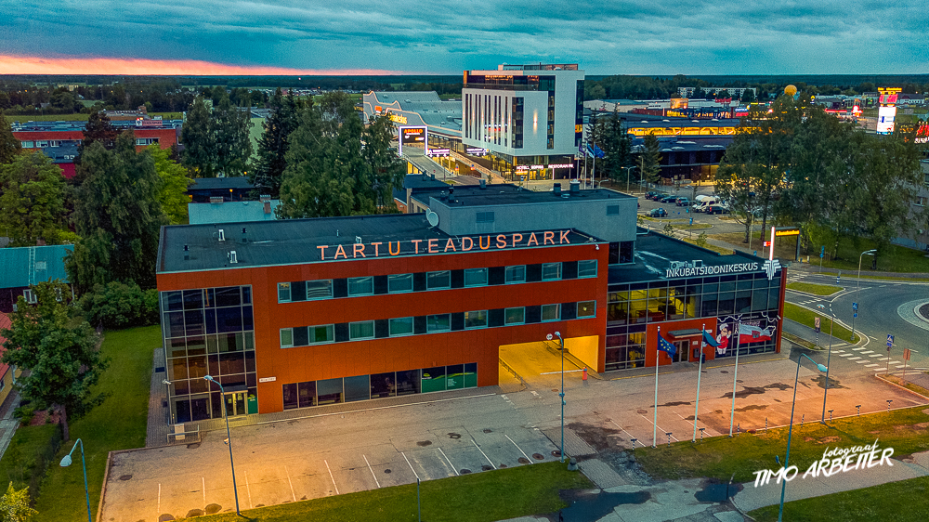

Science Park Campus
12 000m2
60 companies

Slide 7
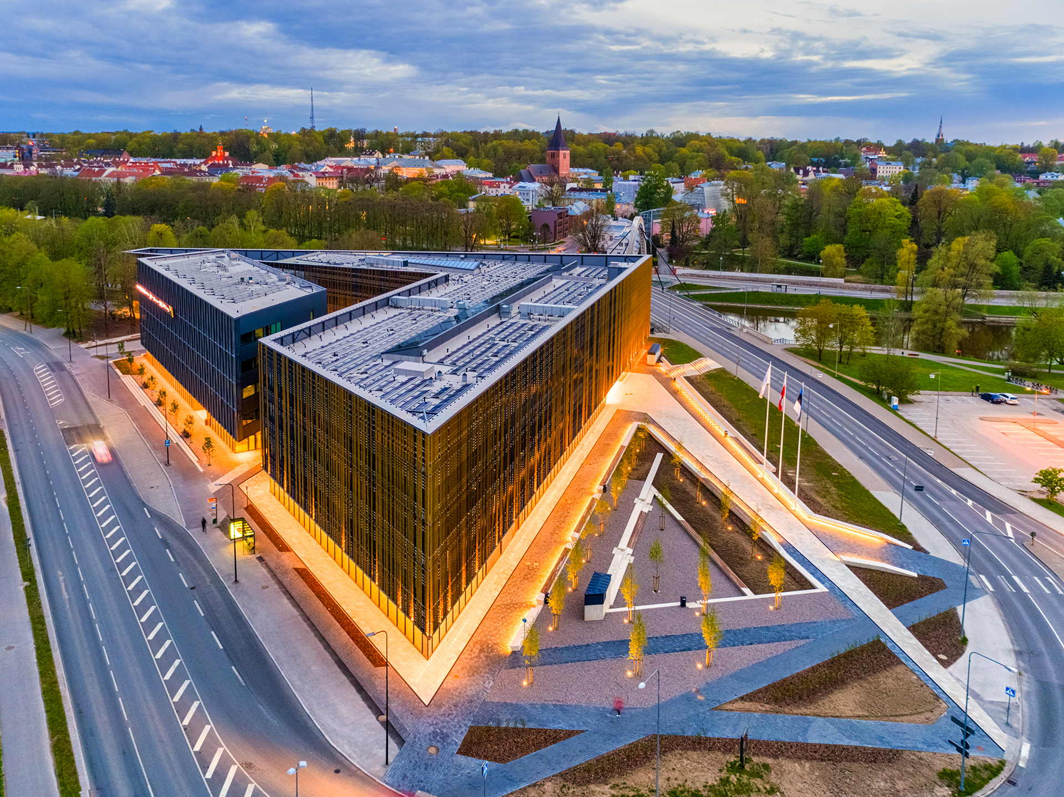

Sparkup Delta Work Space
53 desks
14 companies

Slide 8


Sparkup Incubator
Science to Business Incubation and Acceleration Programs
NATO DIANA
Green Tech Estonia
Accelerator

Slide 9

SPARKUP Incubator
Business development support
up to 12 months
Office and lab spaces
Technical,- business- and scientific support
Use on TSP and Sparkup
brand
€10k equity free funding
Door opener to EBAN, EstBAN, LatBAN, LitBAN, FiBAN
EEN, IASP networks and partnerships
Networking events and workshops

Slide 10







Our active portfolio

Slide 11
Estonia
ESA BIC Estonia
Six years of space tech incubation in Estonia
Sven Lilla
BIC manager

Slide 12
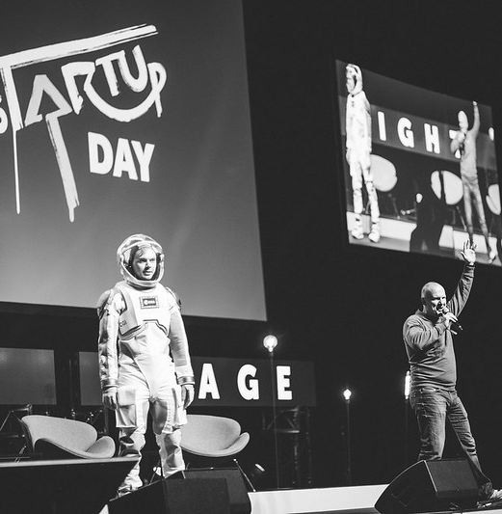
ESA BIC Estonia in a nutshell
Opened in 2017
Two major locations: Tartu and Tallinn
7 partners in consortium
56 applications,
47 pitches in TEB’s
12 Selection campaigns
24 selected start-ups
5 active
17 alumni
2 default

Slide 13





Our active portfolio
Estonia
Developing Digital twing cretion from satellite imagery
Developing Application that recognizes solar panels potential of rooftops by using satellite imagery
Develops autonomous marine vehicles for deep sea surveys
Develops drone operator detection software by using Precision Navigation and Satellite Imagery
Develops universal communication platform for crisis areas by using Satellite Communication

Slide 15



sTARTUp Day 2025
29-31 JANUARY IN TARTU, ESTONIA
THE MOST STARTUP-MINDED BUSINESS FESTIVAL!
thousands of startup-minded attendees
inspiring stage program
world-class speakers
international pitching competitions
hands-on workshops
organized matchmaking
mind-blowing side-events
the most authentic festival vibe
BRINGING TOGETHER STARTUP-MINDED PEOPLE
TO CELEBRATE ENTREPRENEURSHIP
IN THE SMART CITY OF TARTU

Slide 16
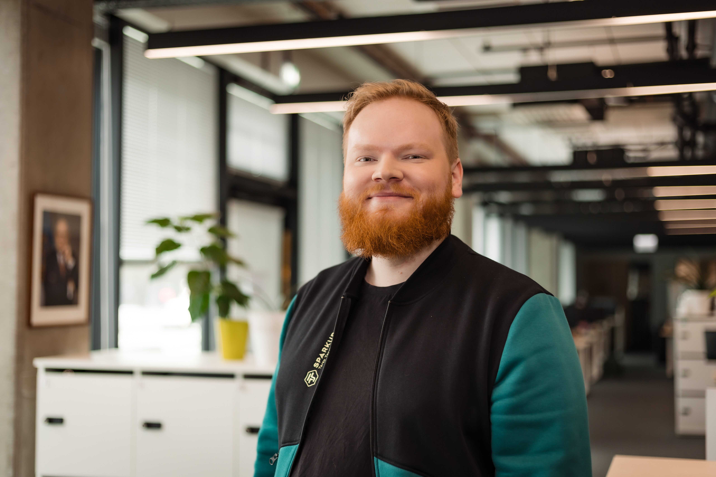
Tänan!
Kristofer Jürisoo
Community Manager
kristofer@teaduspark.ee

