Slide 1
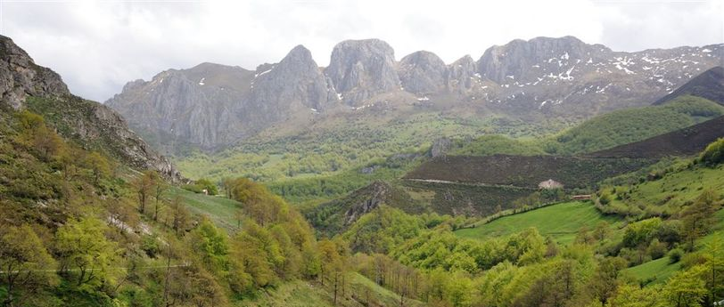





The asturian network
of rural development
reader
VISIT TO ESTONIA
19-26/05/2024

Slide 2
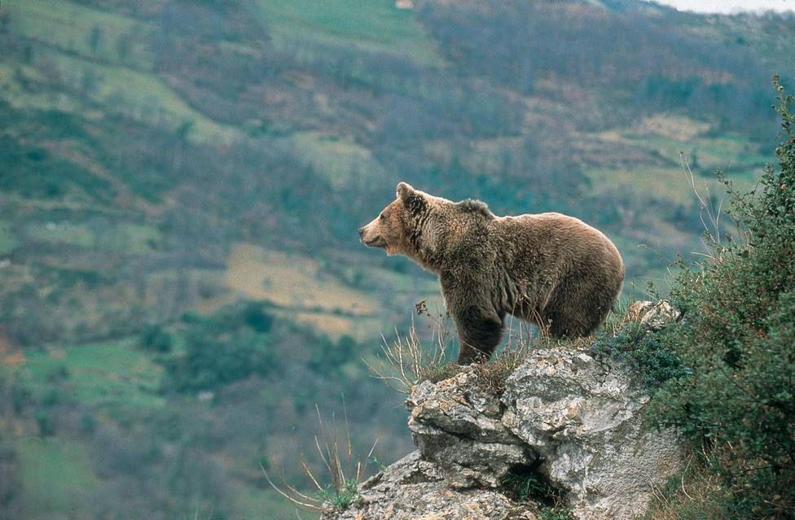
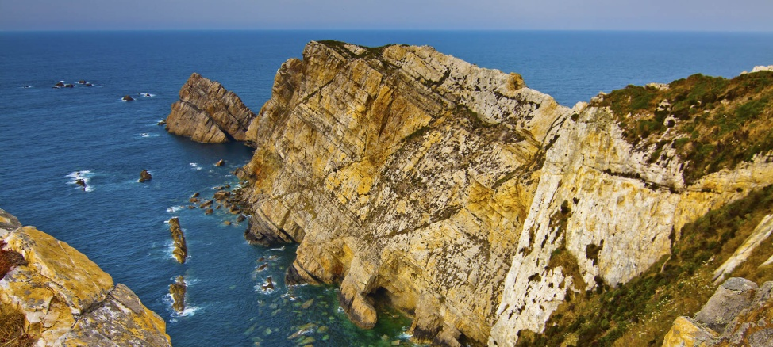
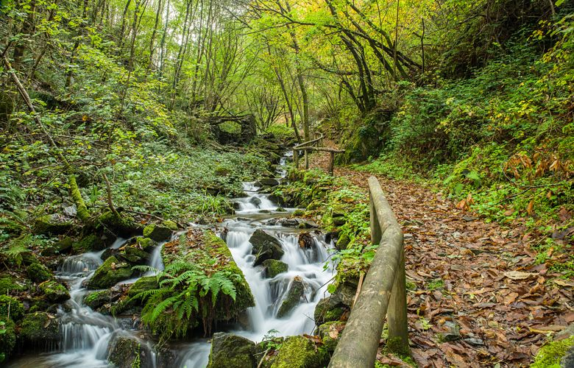
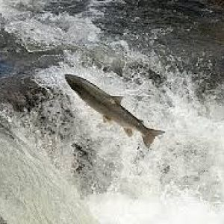
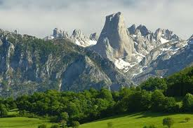
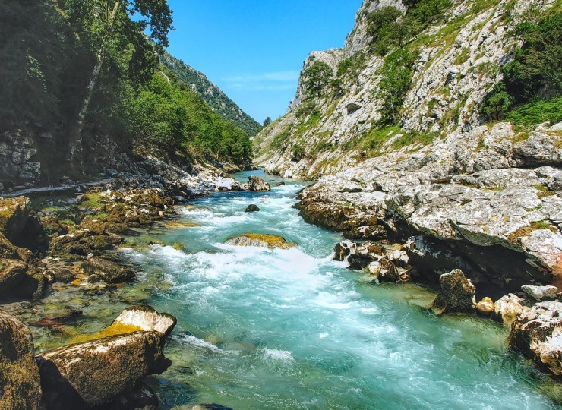

Slide 3


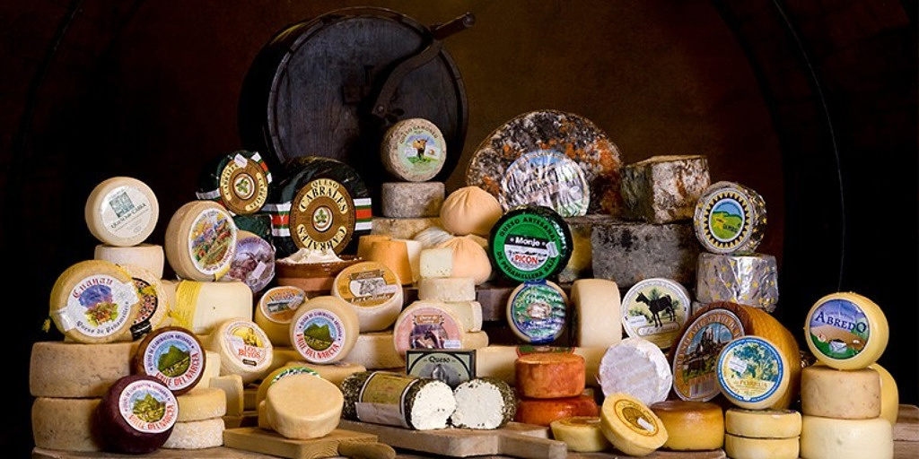

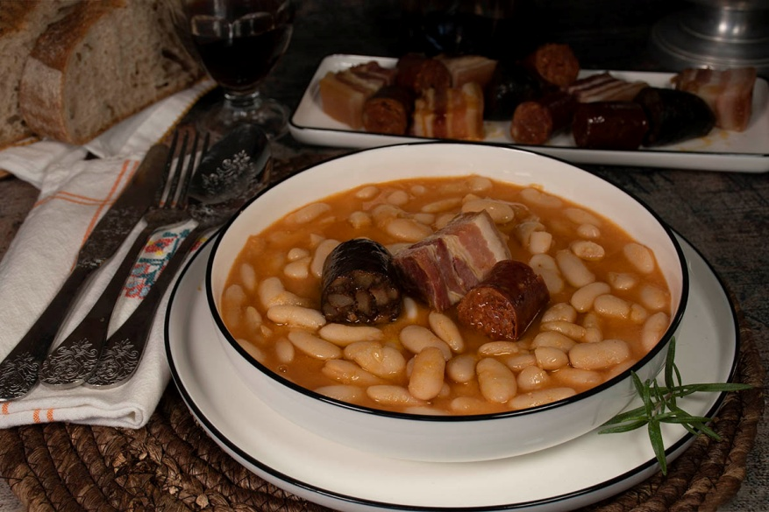


Slide 4
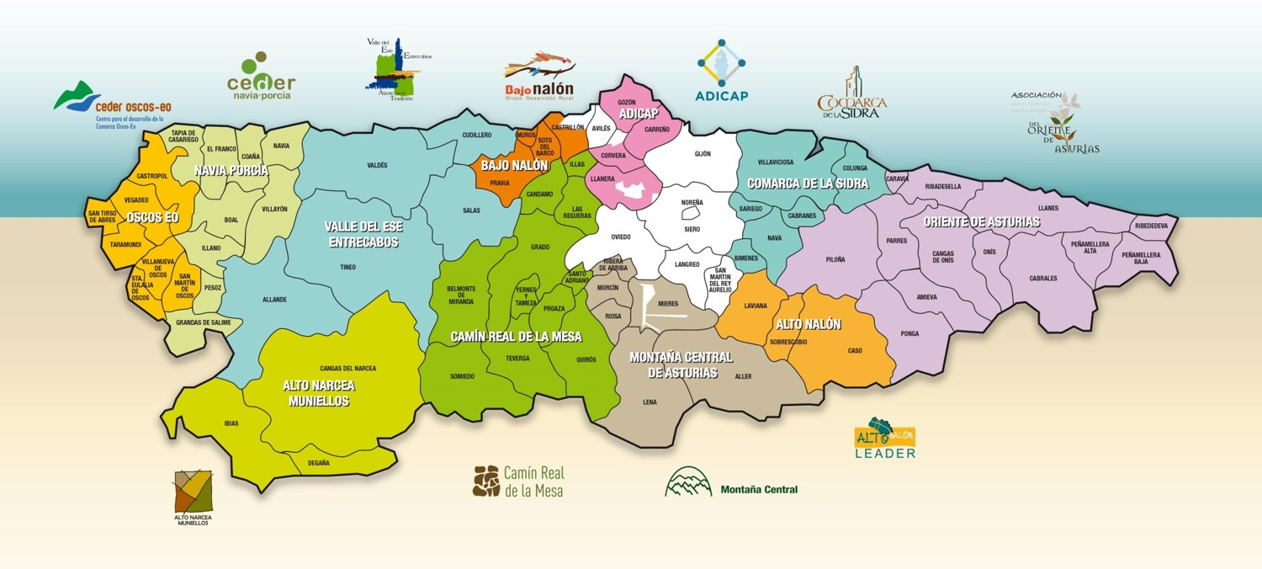
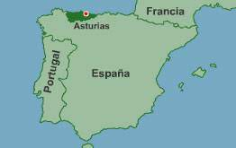

About us
1 million inhabitants / 10,600 km2
80% rural territory / 20% rural population
71 municipalities grouped (of 78) in 11 Local Action Groups

Slide 5













A different kind of Network

Slide 6
Services and functions of READER
Provision of services to the LAGs
Organisation of Conferences, Seminars and all kinds of activities related to the LEADER Programme
Carrying out all kinds of dissemination and communication actions in different formats
Technical Coordination between the LAGs and the Managing Authority
Participation as partner or promoter in different Programmes and Projects
Representation of the LAGs in different structures related to Rural Development
Participation as a member of the Spanish Network for Rural Development (REDR)

Slide 7
READER is LEADER in Asturias
Strong Regional Network READER
At Political Level
LAG Presidents (READER President) Regional Management Authority (Regional Ministry)
Technical level
LAG Managers Technical Team of the Regional Management Authority
DIALOGUE COOPERATION NETWORKING…
Easy to think… easy to make

Slide 8
LEADER in Asturias
Economical development in rural areas (All sectors… innovation and risk)
Except young farmers and cow hatchery we can give grants for all primary sector activities
We are trying to work with integrate strategies from a holistic point of wiew
EFARD + EFMP - LAG+FLAG
We can give grants to enterprises, municipalities and local asociations (private + public + social)
25% of RDP for LEADER (125.000.000 €) + Axis 4 EFMP (8.500.000 €)
LEADER is a small RDP at county level into a RDP at regional level
We need to humanize our targets and objetives
Easy to design… so complicated to make

Slide 9

LEADER in Asturias 2014-2023
The key measure
11 measures,
except livestock
M01.1 PROFESSIONAL TRAINING
M04.1 AGRICULTURAL HOLDINGS
M04.2 AGRICULTURAL INDUSTRIES
M06.2 RURAL TICKET
M06.4 SETTING-UP NON-AGRICULTURAL ACTIVITIES
M07.2 UPGRADING OR EXPANSION OF SMALL-SCALE INFRASTRUCTURES
M07.3 BROADBAND AND E-GOVERNMENT
M07.4 BASIC LOCAL SERVICES AND INFRASTRUCTURE
M07.5 PUBLIC USE AND INFRASTRUCTURE TOURISM
M07.6 CULTURAL AND NATURAL HERITAGE
M08.2 AGROFORESTRY SYSTEMS
Addressed to:
Companies and individuals
Local authorities
Non-profit associations
M6.2 Rural Ticket
500 beneficiaries
+10M €
35.000€ / 3 years

Slide 10
LEADER in Asturias 2014-2023
LOCAL ACTION GROUPS | 2016 (€) | 2017 (€) | 2018 (€) | 2019 (€) | 2020 (€) | 2022 (€) | 2023 (€) | TOTAL (€)
ADICAP | 400.000,00 | 685.409,57 | 768.287,57 | 929.944,00 | 1.184.859,49 | 740.263,00 | 808.078 | 5.516.841,63
ALTO NALÓN | 424.114,00 | 1.080.106,88 | 1.082.579,49 | 1.157.537,00 | 1.837.261,60 | 1.145.487,00 | 1.249.282 | 7.976.367,97
ALTO NARCEA MUNIELLOS | 217.000,00 | 1.319.548,31 | 1.400.093,83 | 1.420.386,00 | 2.228.702,88 | 1.387.491,00 | 1.509.416 | 9.482.638,02
BAJO NALÓN | 928.000,00 | 1.179.318,31 | 1.490.413,54 | 1.257.419,00 | 1.999.349,08 | 1.245.534,00 | 1.358.954 | 9.458.987,93
CAMÍN REAL | 1.000.000,00 | 1.601.182,48 | 1.963.089,07 | 2.033.624,00 | 2.681.737,87 | 1.670.939,00 | 1.823.292 | 12.773.864,42
COMARCA DE LA SIDRA | 1.029.115,25 | 1.233.248,04 | 1.435.194,50 | 1.466.506,00 | 2.090.118,09 | 1.300.464,00 | 1.418.456 | 9.973.645,88
MONTAÑA CENTRAL | 1.253.000,00 | 1.633.923,25 | 2.007.977,90 | 1.934.158,00 | 2.737.657,59 | 1.704.618,00 | 1.859.435 | 13.130.769,74
NAVIA PORCÍA | 1.320.000,00 | 1.984.220,47 | 2.513.405,56 | 2.540.689,00 | 3.306.584,65 | 2.057.248,00 | 2.244.535 | 15.966.682,68
ORIENTE | 900.000,00 | 2.044.420,69 | 2.440.565,37 | 2.634.492,00 | 3.403.837,14 | 2.117.493,00 | 2.309.516 | 15.850.324,20
OSCOS EO | 708.507,87 | 907.413,81 | 1.148.202,10 | 1.234.853,00 | 1.562.523,32 | 972.265,00 | 1.060.288 | 7.594.053,10
VALLE DEL ESE ENTRECABOS | 2.031.330,55 | 2.074.239,18 | 2.541.280,94 | 3.145.277,00 | 3.465.268,29 | 2.158.198,00 | 2.358.750 | 17.774.343,96
TOTAL | 10.211.067,67 | 15.743.030,99 | 18.791.089,87 | 19.754.885,00 | 26.497.900,00 | 16.500.000,00 | 18.000.000 | 125.498.519,53
In 2019 was increased from 70 million euros to 111,5 million euros and then to 125,000,000 € and…. 2024 + 16,500,000 € to increase total budget
Representing 25% RDP (the average in Spain is 8%)
Second region in Europe that allocates the most

Slide 11
LEADER in Asturias 2024(25)-27(29)
Our Tools
Strong Regional Network - READER involved in projects (Coperation…)
OCS + Multifund… more efficient management at global level… less bureaucracy
LAGS in the future (now…) …more than LEADER (EFMPA SFE EUNG…)
From Regional level County level to Local level
Productive sectors + Sectors of high strategic interest… holistic and integrated point of view for Rural Development
25% PEPAC in Asturias (11% National average)
Putting things in order - Thinking – Acting…take your time

Slide 12
The key measure in Asturias LEADER 2025-29
a) PRODUCTIVE
1. Modernisation and improvement of the competitiveness of agricultural, livestock and forestry holdings 2. Modernisation and improvement of the competitiveness of the agro-industry
3. Investment for the mitigation, adaptation to climate change and energy efficiency of enterprises
4. Creation and modernisation of enterprises in non-agricultural economic activities
5. Job creation in rural areas. TICKET
6. Job creation in rural areas. EMPLOYEE
7. Technological developments and innovation for the improvement of production processes
b) NON-PRODUCTIVE
8. Investments in local public services and infrastructures (Municipalities)
9. Dynamisation of the associative network in rural areas (Local Association)
c) COOPERATION
10. National and international cooperation (LAG)
11. Projects of high strategic interest (LAG)

Slide 13
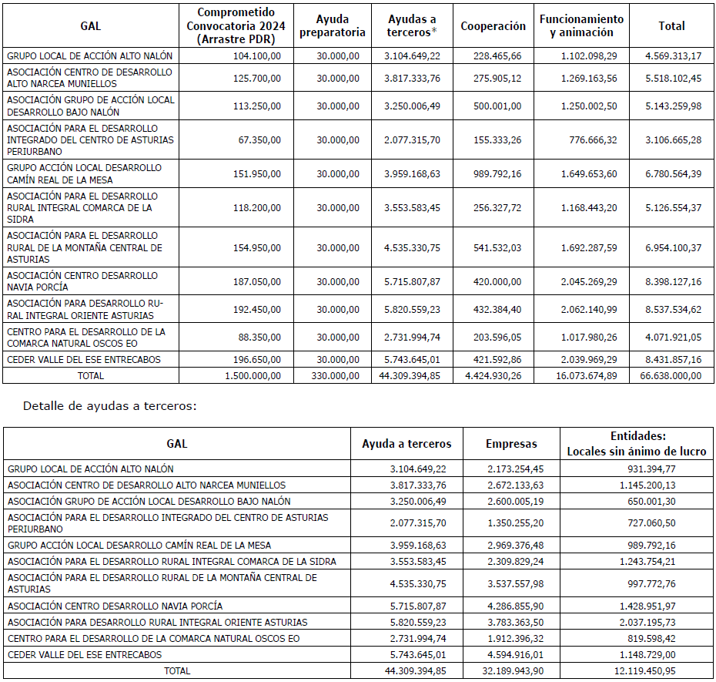
LEADER Budget in Asturias 2025-2029

Slide 14
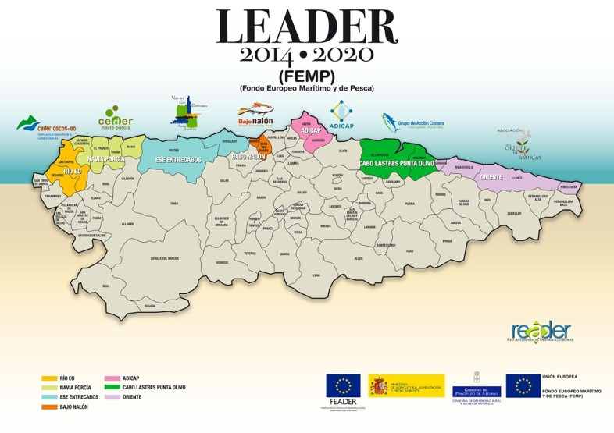

Fisheries Local Action Groups
European Maritime and Fisheries Funds (EMFF)
(Sustainable Development of Fisheries Areas)
7 FLAGs
8M euros

Slide 15
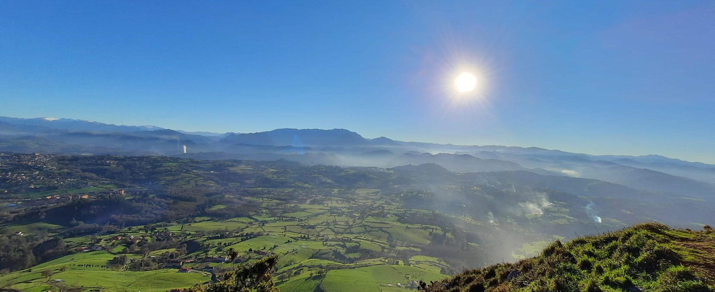
“There is no territory without a future,
but a territory without a project”
Jaime Izquierdo Vallina
Ex Commissioner for the Demographic Challenge
in Asturias
www.readerasturias.org

