Slide 1




presents:
Arts of Survival
Oliver Berg
Tartu with Europe
Programme Line Manager
21st of May 2024

Slide 2
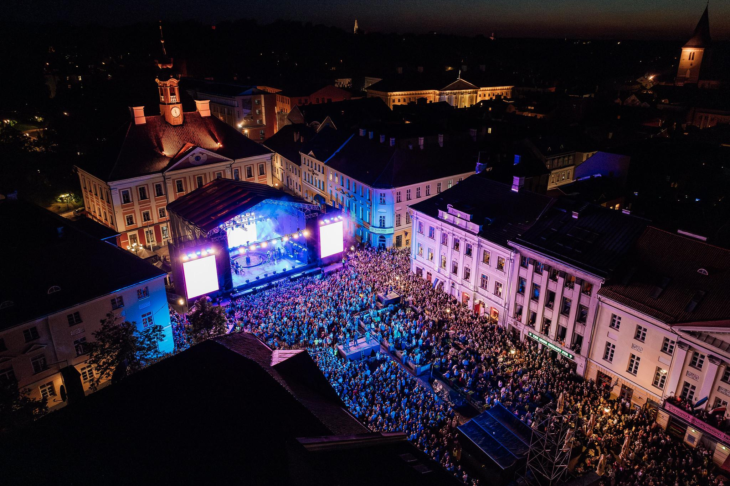
A year like no other!

Slide 3


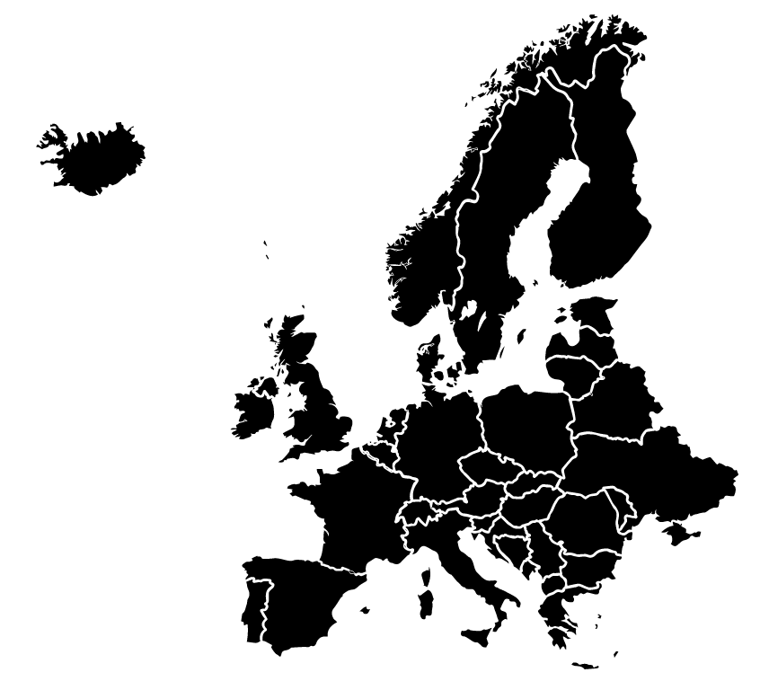


Artistic Concept
Arts of Survival
refers to the knowledge,
skills, and values that will
help us lead a good life
in the future.

Slide 4
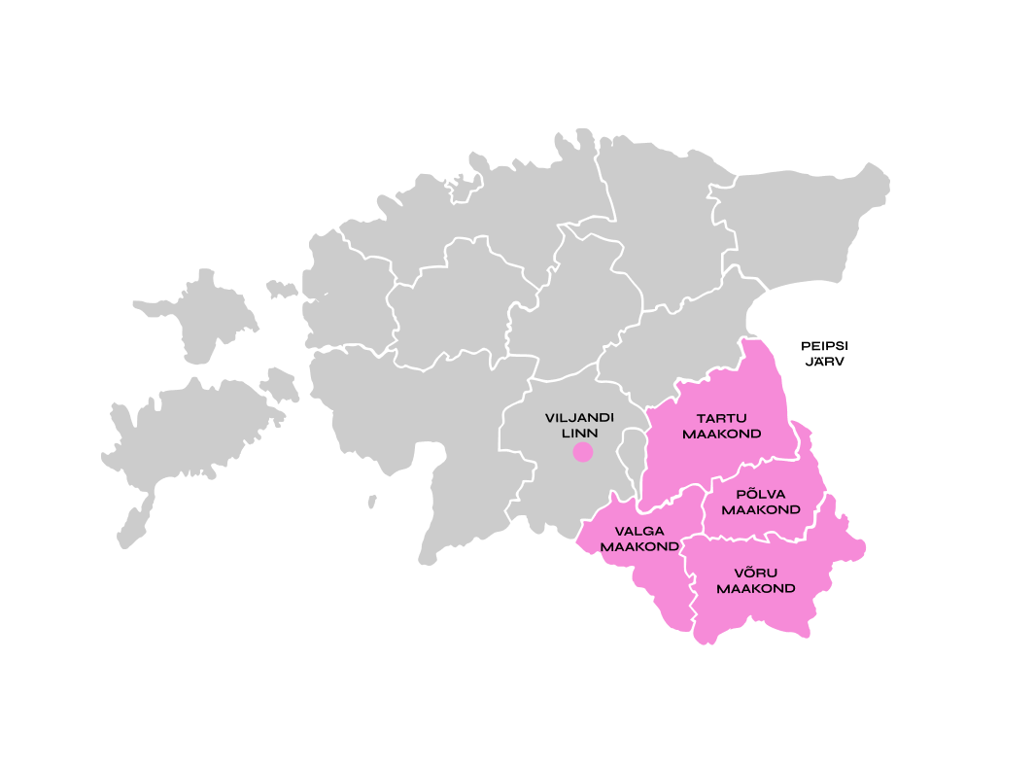


Tartu 2024 in Estonia
Tartu and Southern Estonia’s largest joint venture
(20 municipalities)
Quarter of Estonia celebrating
Tartu 2024 title year
Several different local traditions and customs

Slide 5


Slide 6

That will lead
to more than
1,000
events!

Slide 7





Projects belong
to programme lines:

Slide 8



Sustainability:
Guidelines for organising
environmentally friendly and accessible events
Volunteers:
More than 250 local and
international volunteers contribute to the
success of Tartu 2024
Some of the
Key Focus
Areas for
Tartu 2024
Youth:
Tartu 2024 Extended programme
for 14-19 year-olds, empowering them
to organize cultural events tailored
to their peers (3x24 youngsters)

Slide 9



Tartu with Earth
How to be more nature-friendly in daily urban existence
Find new adaptation strategies in our daily lives as people who create and experience art.
Noticing the biodiversity, sustainable architecture, food, fashion and delve into the connections between nature and culture

Slide 10
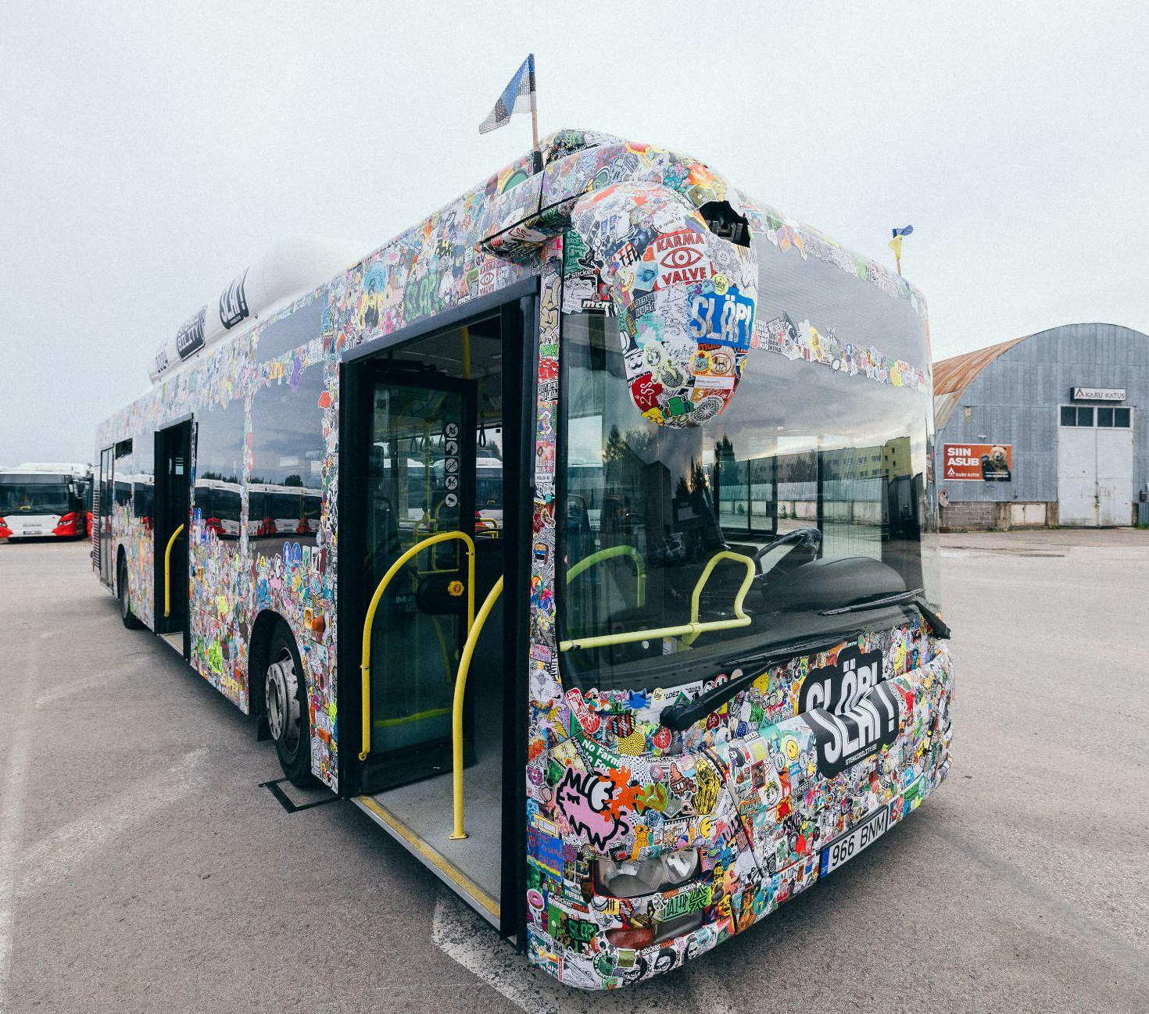


Stencibility Goes Europe
4-7 July – Tartu
Introducing special features
of Tartu street art in Europe
Street Art Exhibition in Berlin (2022),
Aberdeen (2023), the Stencibility exhibition
in Tallinn and the Festival in Tartu (2024)
Europe's largest sticker exhibition on wheels
(250K stickers from artists around the world)

Slide 11
Tartu with Humanity
Restore trust in human closeness
Learning skills through drama, music and art
Speaking about physical and mental health, improving children’s social skills and mutual understanding, bringing the potential of special people out of the shadows

Slide 12
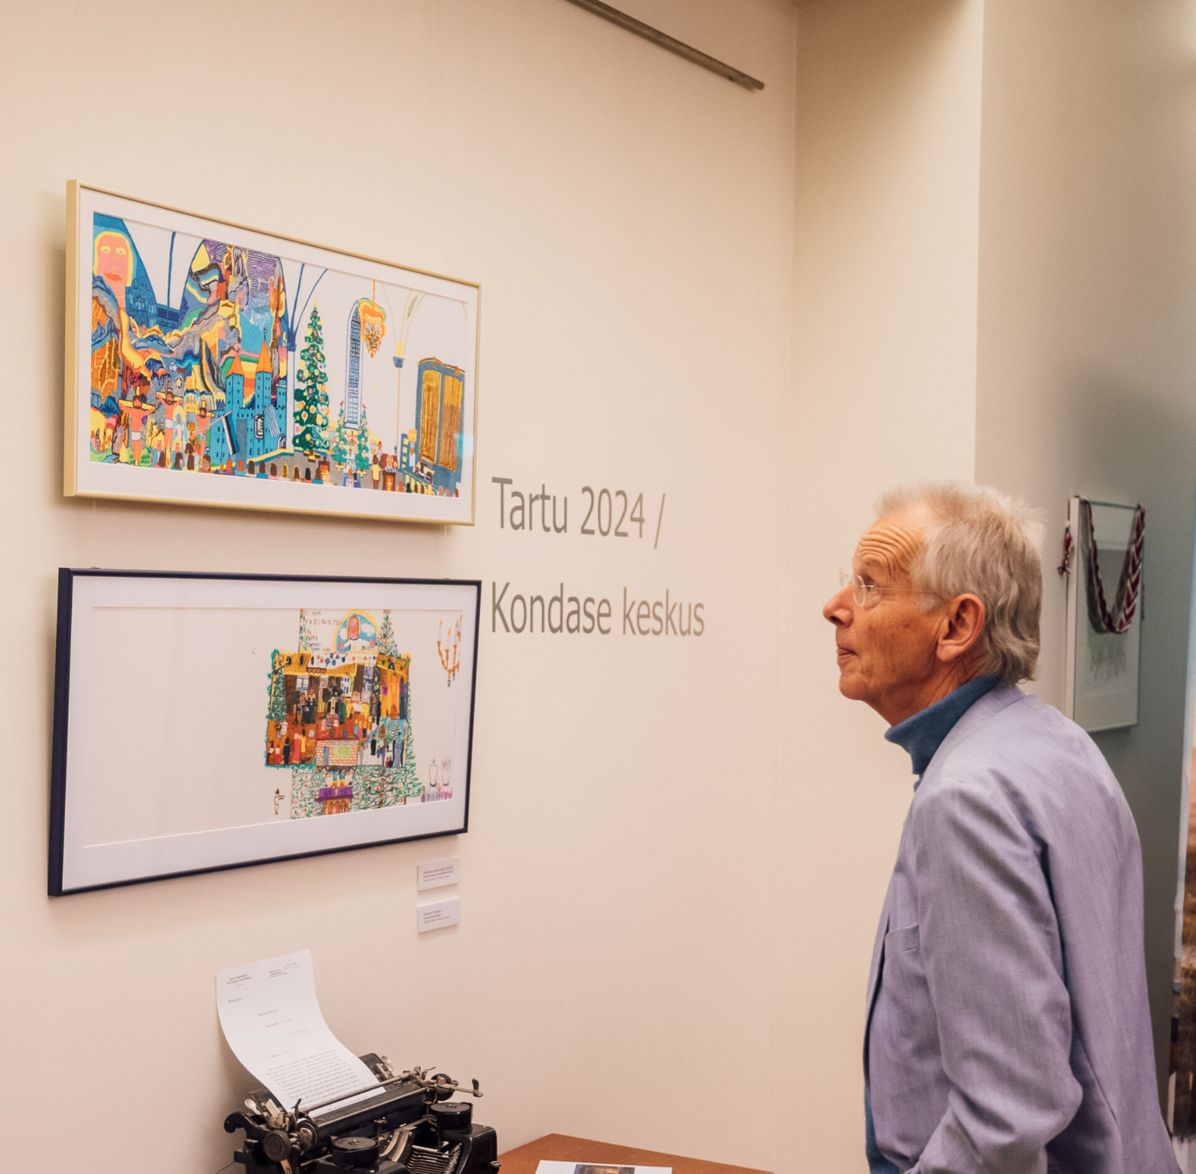
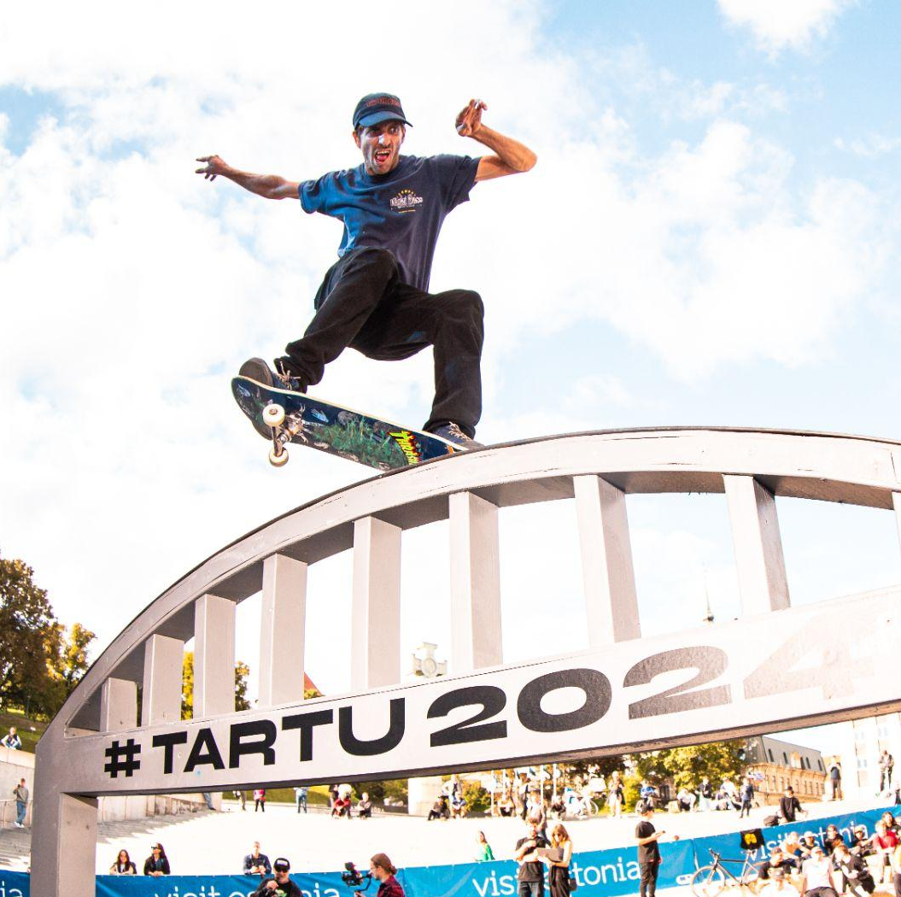
Hidden Worlds Expanding
29 May- 29 September – Viljandi, Valga and Tartu
Led by Kondas Centre in Viljandi
Faculty of Education Masaryk Uni. in Brno (CZ)
Psychiatric Art Collection of the Hungarian
Academy of Sciences (HU)
Silesian Museum in Katowice (PL)
ARTBRUT from Serbia (Goran Stojcetovic)(RS)
Also partners from Finland, Latvia, Germany
and Austria.

Slide 13

Tartu with Europe
Bringing the European dimension of Tartu 2024 to the minds of everyone in Tartu and Southern Estonia
Making Europe aware that we are also part of its diversity with our local languages and customs
Special traits to share with Europe and beyond
Listening to local voices, concerns and wishes, as well as European public intellectuals and finding common solutions to similar European cities and regions

Slide 14
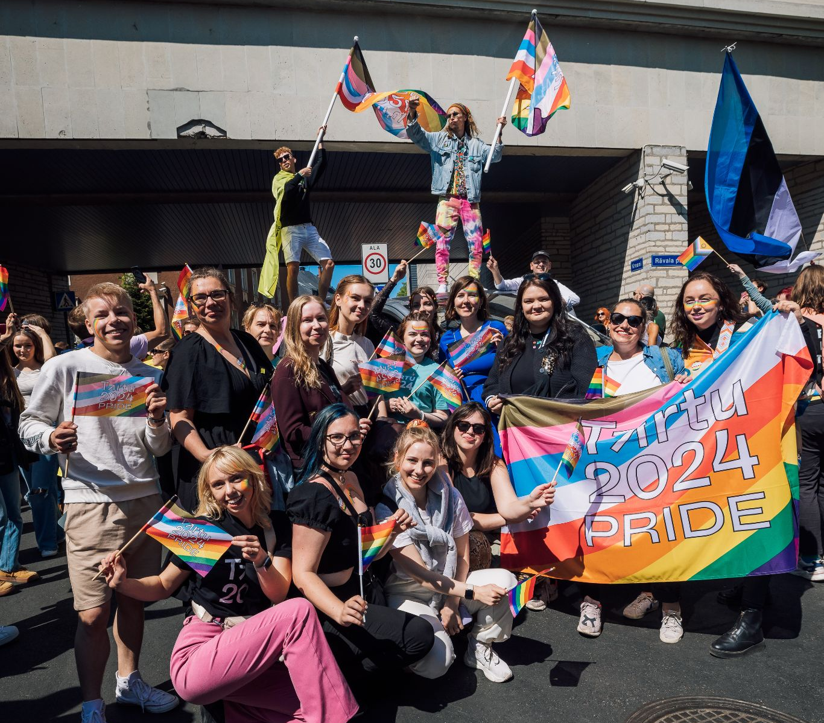
Tartu 2024 Pride
12-18 August – Tartu
LGBT+ Culture Festival
A week long programme ranging from performance art to literature and music
Emphasing that the Tartu 2024 programme is for everybody

Slide 15

Tartu with Universe
Fostering cooperation between the arts and scientific research
Encouraging debate and artistic creativity in imagining utopias, dystopias and ecotopias
Addressing the cultural and social impact of AI
Spreading knowledge of agriculture, sports and landscape architecture through the arts and from a scientific perspective

Slide 16
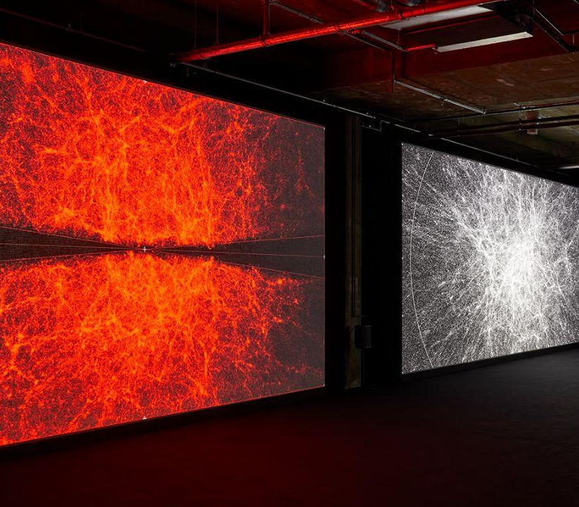
Ryoji Ikeda’s Solo Exhibition
1.11.24-2.3.25 – Tartu, Estonian National Museum
Japan’s leading electronic music composer
and visual artist
Audiovisual installation based on the research
data from the University of Tartu’s Institute of
Genomics
Sound installation created in collaboration
with the Estonian Philharmonic Chamber Choir
Ikeda’s earlier work Supersymmetry (2014)
was also inspired by science and was created
during the art residency at CERN

Slide 17
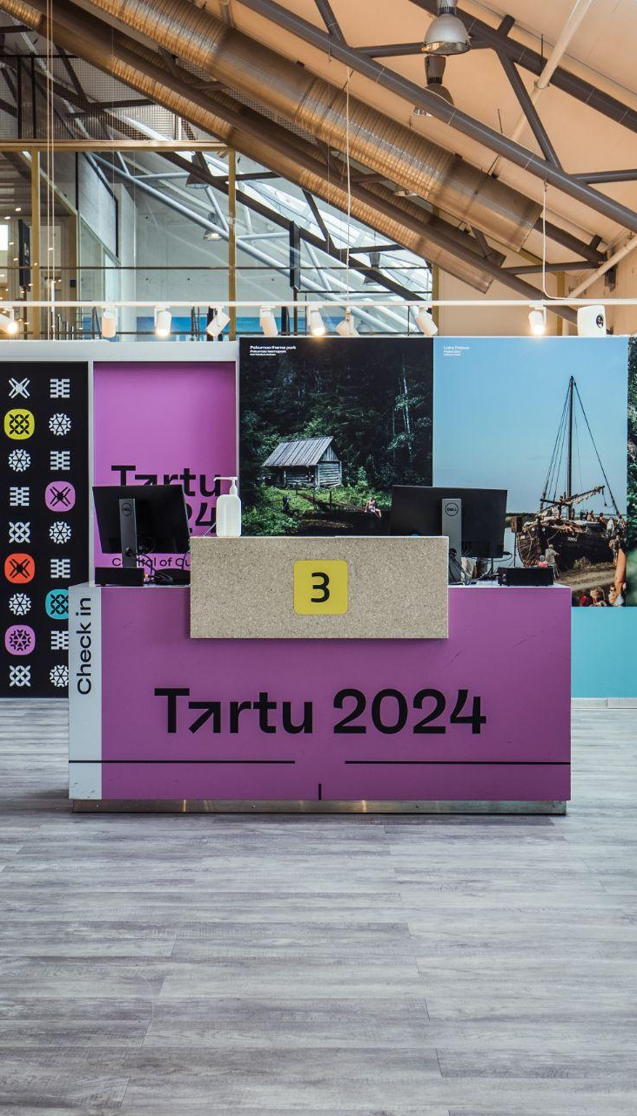
Tartu 2024 focus markets
  Latvia
  Finland
  Lithuania
  United Kingdom
  Germany

Slide 18
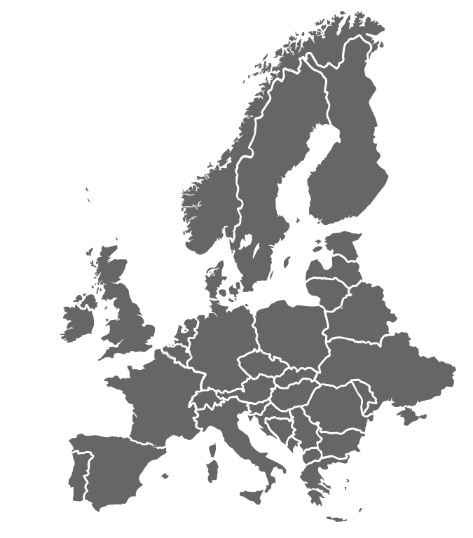
European Capital of Cultures
BODØ 2024
TARTU 2024
KAUNAS 2022
CHEMNITZ 2025
ESCH 2022
VESZPRÉM 2023
BAD ISCHL 2024
NOVA GORICA/
GORIZIA 2025
NOVI SAD 2022
TIMIȘOARA 2023
ELEFSINA 2023
Notes:
2022: Kaunas (Leedu), Esch (Luksemburg), Novi Sad (Serbia)
2023: Veszprém (Ungari), Timișoara (Rumeenia), Elefsina (Kreeka)
2024: Tartu (Eesti), BodØ (Norra), Bad Ischl (Austria)
2025: Chemnitz (Saksamaa), Nova Gorica/Gorizia (Sloveenia, Itaalia)

Slide 19
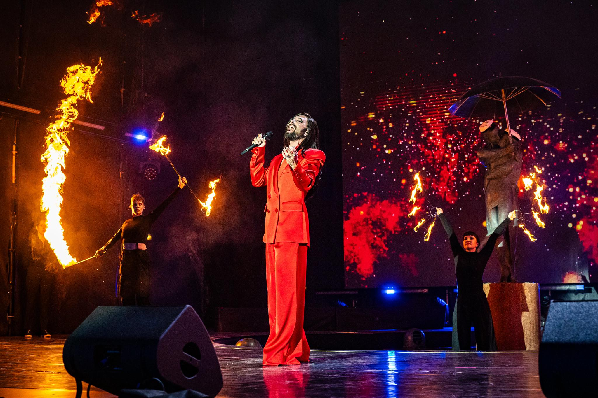


Explore
the entire
programme
Enjoy Tartu !
Notes:
SIIN LÕPPEB ESITLUS!!!

